Slide 1
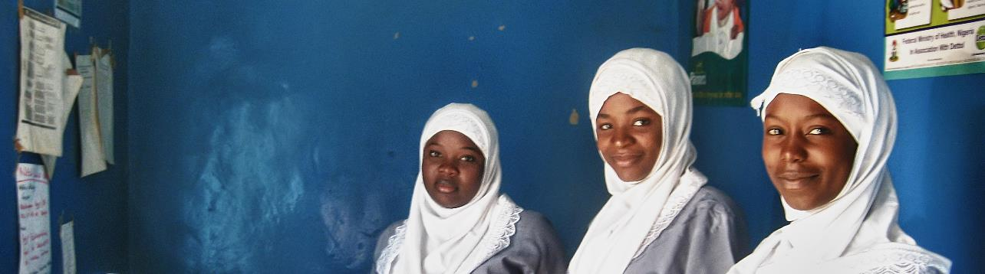
TB, Health Insurance
and Social Protection
TBS2018
Elaine Baruwa, July 2018
© 2009 eHealth Africa, Courtesy of Photoshare

Slide 2

HFG works to strengthen
health systems in countries around the world.
HFG Site Office
HFG Activity
Ukraine
Georgia
Kyrgyzstan
Armenia
Azerbaijan
Bahamas
Antigua & Barbuda
Bangladesh
Dominica
Mali
Barbados
Vietnam
Haiti
St Lucia
Senegal
St Kitts & Nevis
Dominican Republic
St. Vincent & the Grenadines
Nigeria
India
Myanmar
Philippines
Guatemala
Trinidad & Tobago
Guinea
Cambodia
Guyana
Côte d’lvoire
Ghana
Ethiopia
Suriname
Benin
Cameroon
Kenya
Indonesia
Dem. Rep.
of The Congo
Burundi
Peru
Angola
Tanzania
Timor Leste
Zambia
Namibia
Botswana
Mozambique
Malawi
South Africa
Lesotho
Swaziland

Slide 3
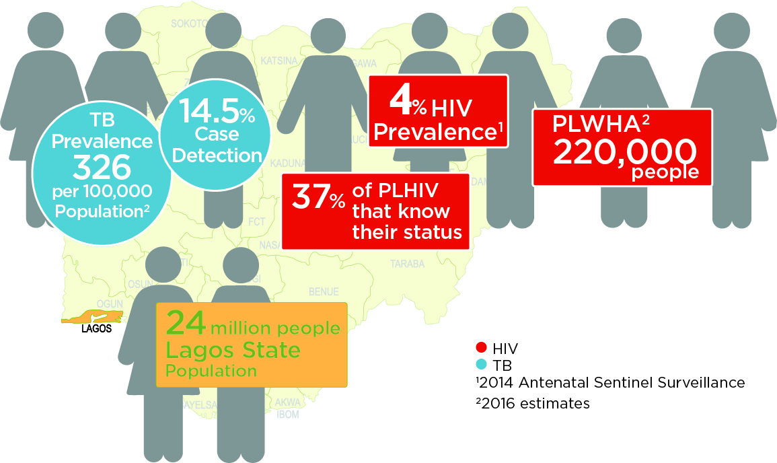
But today, we’ll share
our Lagos State, Nigeria experience to illustrate

Slide 4
In a world filled with risks,
social protection systems help
individuals and families especially
the poor and vulnerable
cope with crises & shocks,
find jobs, invest in the health
and education of their children,
and protect the aging population.
The World Bank

Slide 5
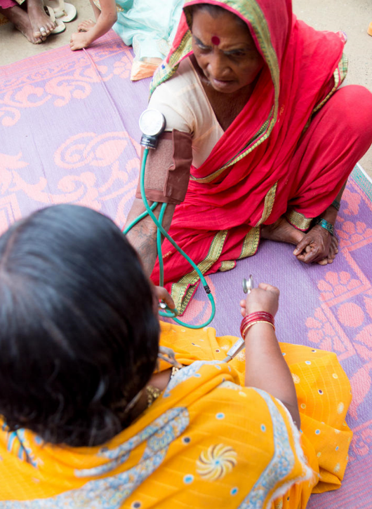
Health insurance
and financing
Collecting revenue
Reduce out of pocket expenses
Pooling
Cross subsidize
Spread costs and mitigate risk
Purchasing
Influence provider behavior
Health insurance is
one (only one) way
to lower risks arising
from poor health
© 2012 Meagan Harrison, Courtesy of Photoshare

Slide 6
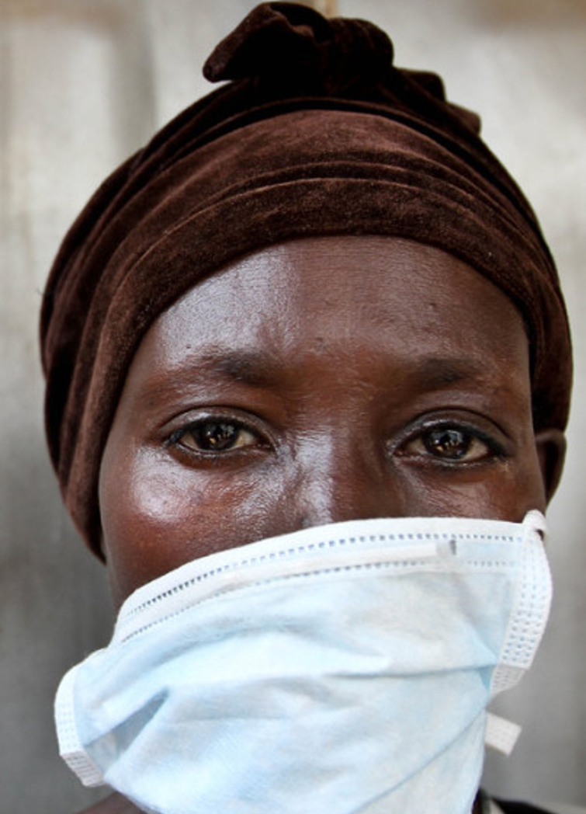
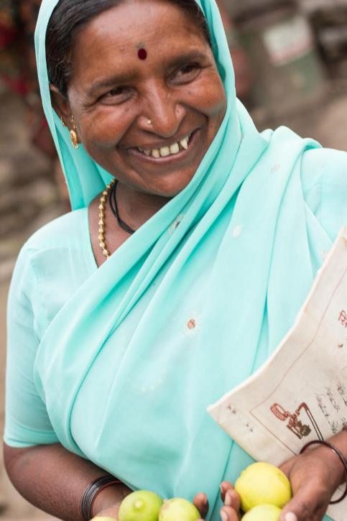
Why use health insurance for TB?
Lagos State Health Scheme – sustainable domestic financing
Increase uptake
Why not?
Nigeria MoH: it’s free already – don’t include it
Yes but …
© 2012 Meagan Harrison, Courtesy of Photoshare

Slide 7
Who pays for what depends on the what ...
Free immunization programs
Out of pocket testing and consultation
  Presumptive vs diagnosed
Free TB treatment programs
Preventive: BCG vaccine for Newborns
TB Screening & Diagnosis
TB DOTS Treatment
Screening & Diagnosis for DRTB
Treatment for DRTB
In-patient Admission
Median direct pre-diagnosis/diagnosis cost: $49 per patient
Median direct treatment cost : $36 per patient
Indirect pre-diagnostic and treatment costs: $416
Ukwaja et al 2013: The High Cost of Free TB Programs

Slide 8
TB expenditures when TB is “free”
State Health Accounts, Lagos State, Nigeria

Slide 9
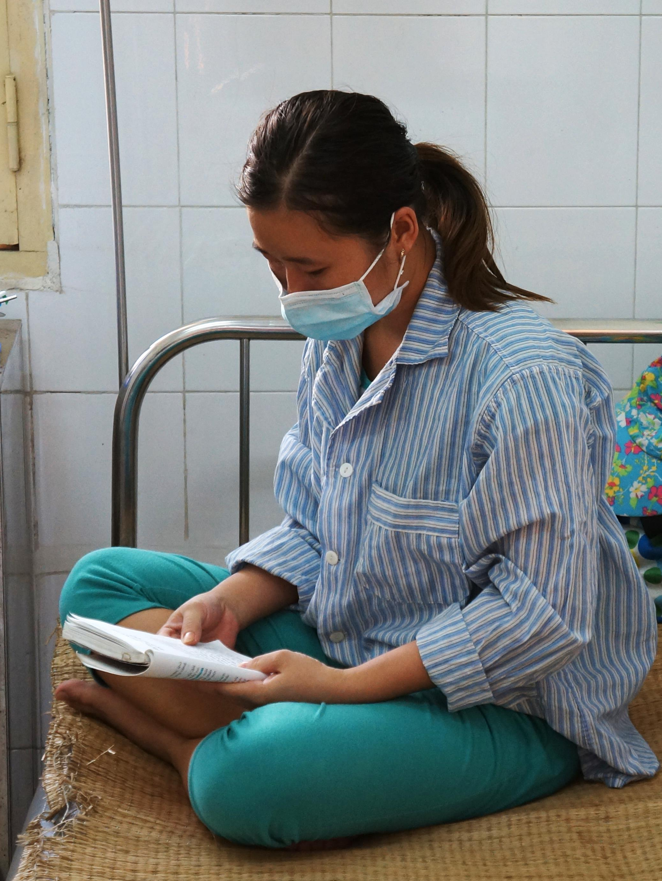
Getting TB into the Benefit Package
Financial feasibility
Technical feasibility
Coordination & Integration
© 2011 Yolanda Barbera Lainez/IRC, Courtesy of Photoshare
Photo Credit: WHO/E. Eraly

Slide 10
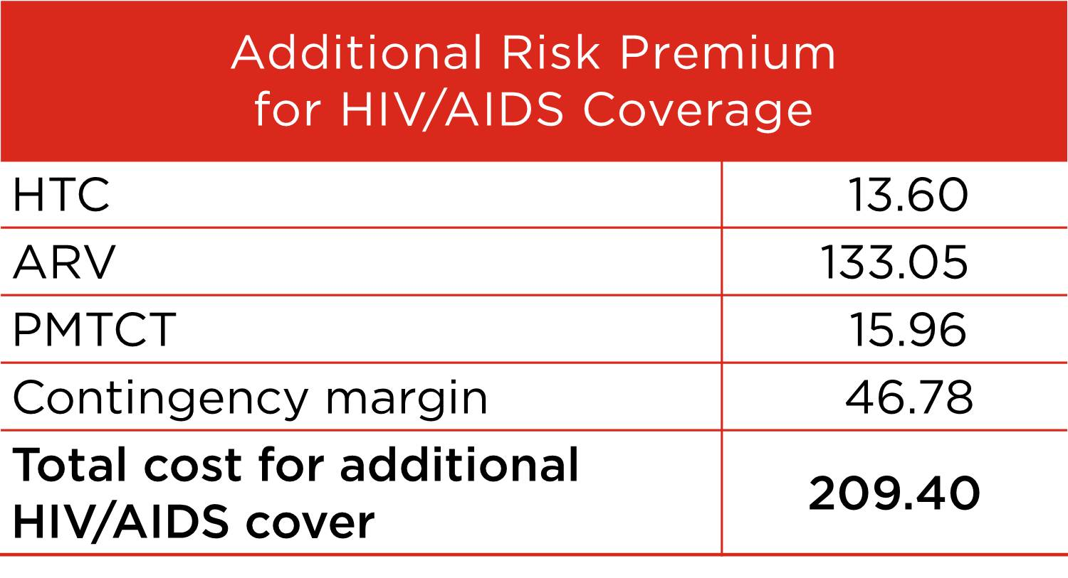
Actuarial analysis
Lagos State Health Scheme (at 20% coverage)
Annual premium $ per cap: $28.00
HIV/AIDS Coverage: + $0.68
TB Coverage: + $1.60
*
*
* Nigerian Naira (NGN 340:US $1)
* Nigerian Naira (NGN 306 :US $1)

Slide 11
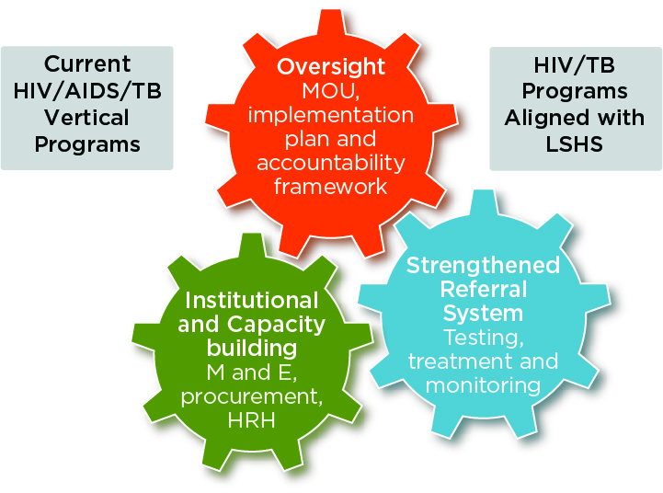
“Some” assembly required …

Slide 12
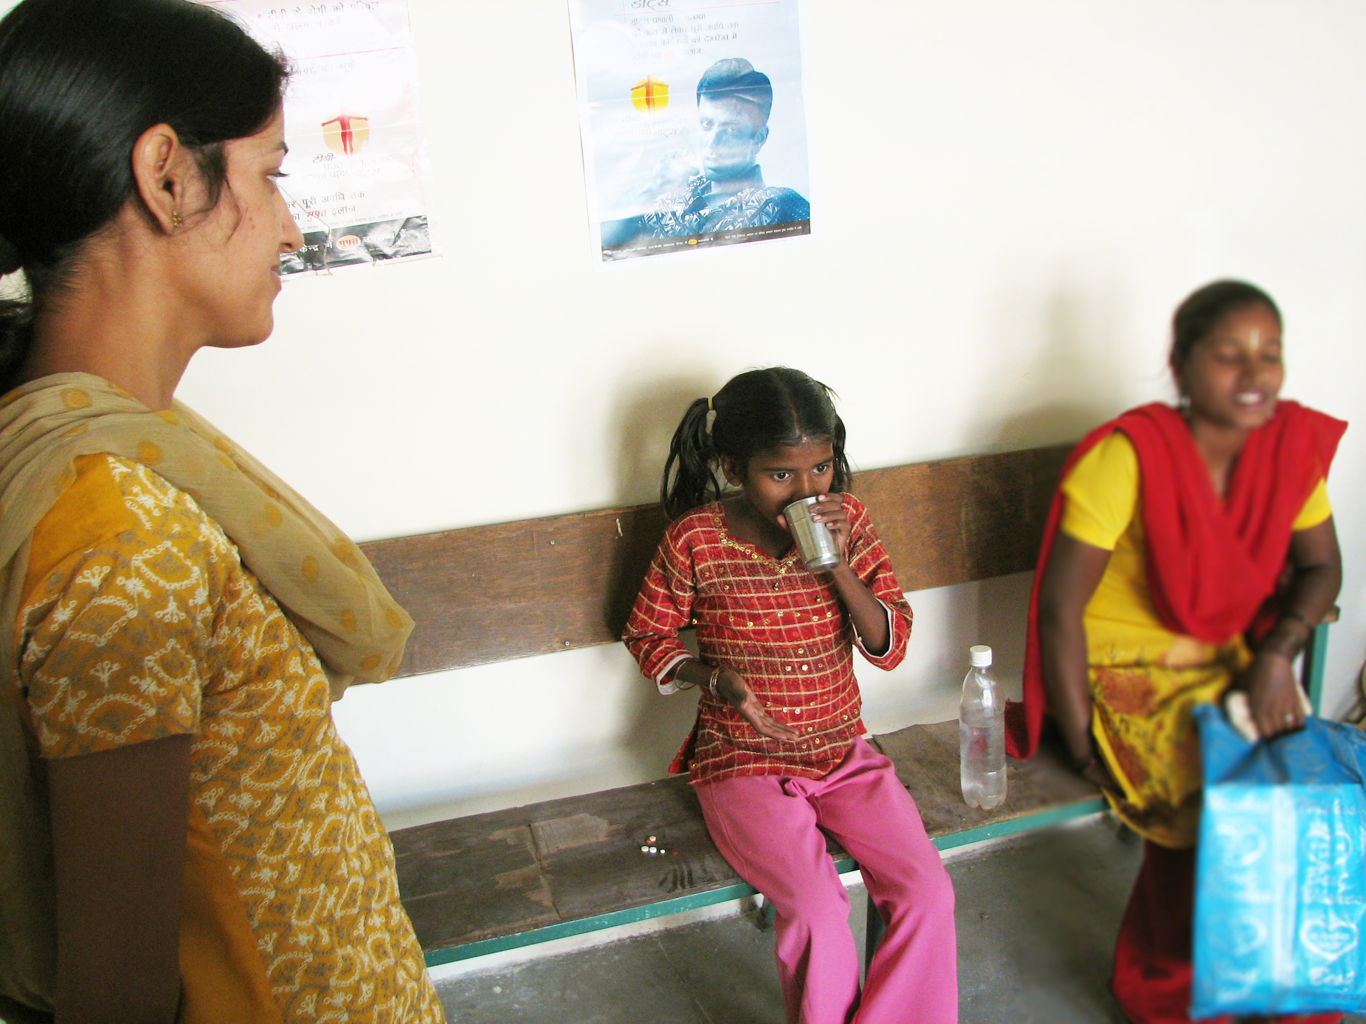
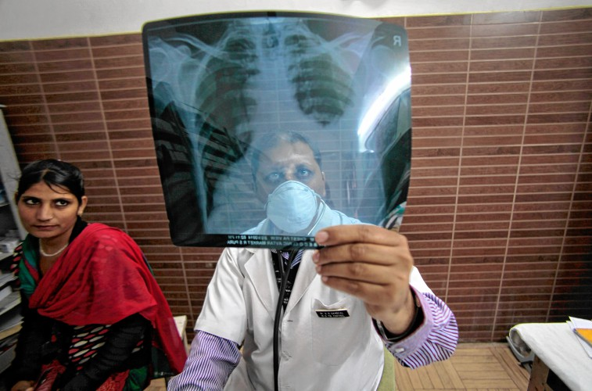
© 2006 S. Loganathan (student)/CHRI, Courtesy of Photoshare
Credit: WHO/M.Grzemska
Credit: WHO/M.Grzemska
Thank You!
Dr Sylvester Akande
Dr Frances Ilika
Dr Funto Ogundapo
Ms Harriet Udeme
Follow us!
On the web at www.HFGproject.org
On Twitter at @HFGproject
On Facebook at www.facebook.com/hfgproject
The HFG project is funded by the United States Agency for International Development (USAID) under cooperative agreement No. OAA-A-12-00080.
The author's views expressed in this presentation do not necessarily reflect the views of USAID or the United States government.

